Slide 1
Search Techniques

Slide 2
Searching for a (shortest / least cost) path to goal state(s).
Search through the state space.
We will consider search techniques that use an
explicit search tree that is generated by the
initial state + successor function.
initialize (initial node)
Loop
choose a node for expansion according to strategy
goal node? → done
expand node with successor function

Slide 3
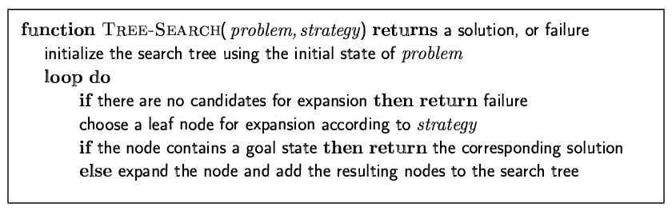
Tree-search algorithms
Basic idea:
simulated exploration of state space by generating successors of already-explored states (a.k.a. ~ expanding states)
Fig. 3.7 R&N, p. 77
Note: 1) Here we only check a node for possibly being a goal state, after we select the node for expansion.
2) A “node” is a data structure containing state + additional info (parent
node, etc.

Slide 4
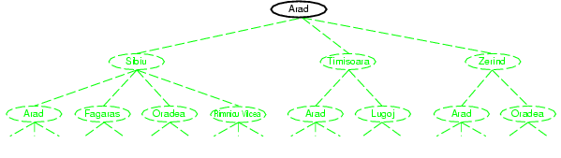
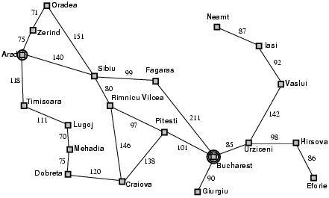
Tree search example
Node selected
for expansion.

Slide 5
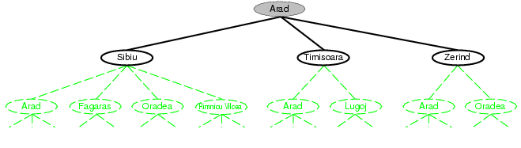
Nodes added to tree.

Slide 6
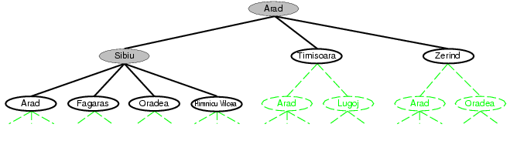
Selected for expansion.
Added to tree.
Note: Arad added (again) to tree!
(reachable from Sibiu)
Not necessarily a problem, but
in Graph-Search, we will avoid
this by maintaining an
“explored” list.

Slide 7
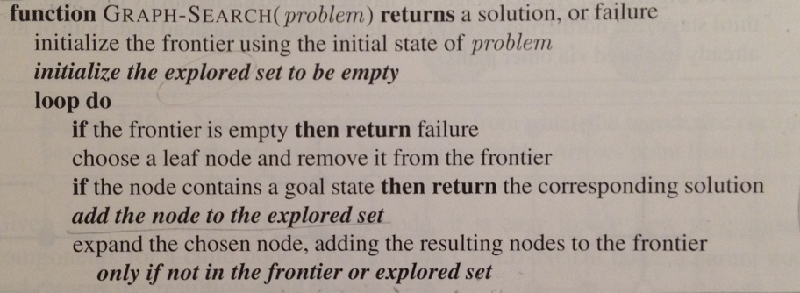
Graph-search
Fig. 3.7 R&N, p. 77. See also exercise 3.13.
Note:
1) Uses “explored” set to avoid visiting already explored states.
2) Uses “frontier” set to store states that remain to be explored and expanded.
3) However, with eg uniform cost search, we need to make a special check when
node (i.e. state) is on frontier. Details later.

Slide 8
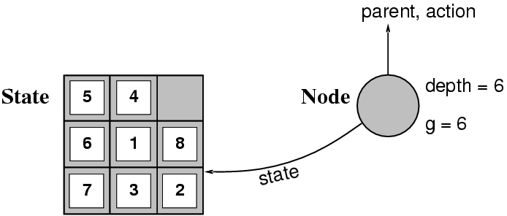
Implementation: states vs. nodes
A state is a --- representation of --- a physical configuration.
A node is a data structure constituting part of a search tree includes state, tree parent node, action (applied to parent), path cost (initial state to node) g(x), depth
The Expand function creates new nodes, filling in the various fields and using the SuccessorFn of the problem to create the corresponding states.
Fringe is the collection of nodes that have been generated but not (yet)
expanded. Each node of the fringe is a leaf node.

Slide 9
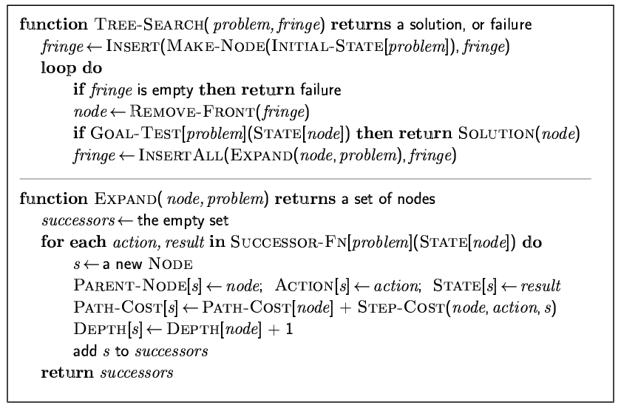
Implementation: general tree search

Slide 10
Search strategies
A search strategy is defined by picking the order of node expansion.
Strategies are evaluated along the following dimensions:
completeness: does it always find a solution if one exists?
time complexity: number of nodes generated
space complexity: maximum number of nodes in memory
optimality: does it always find a least-cost solution?
Time and space complexity are measured in terms of
b: maximum branching factor of the search tree
d: depth of the least-cost solution
m: maximum depth of the state space (may be ∞)

Slide 11
Uninformed search strategies
Uninformed (blind) search strategies use only the information available in the problem definition:
Breadth-first search
Uniform-cost search
Depth-first search
Depth-limited search
Iterative deepening search
Bidirectional search
Key issue: type of queue used for the fringe of the search tree
(collection of tree nodes that have been generated but not yet
expanded)

Slide 12
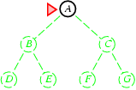
Breadth-first search
Expand shallowest unexpanded node.
Implementation:
fringe is a FIFO queue, i.e., new nodes go at end
(First In First Out queue.)
Fringe queue: <A>
Select A from
queue and expand.
Gives
<B, C>

Slide 13
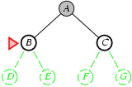
Queue: <B, C>
Select B from
front, and expand.
Put children at the
end.
Gives
<C, D, E>

Slide 14
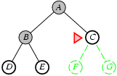
Fringe queue: <C, D, E>

Slide 15
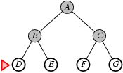
Fringe queue: <D, E, F, G>
Assuming no further children, queue becomes
<E, F, G>, <F, G>, <G>, <>. Each time node checked
for goal state.

Slide 16
Breadth First Search

Slide 17
Properties of breadth-first search
Note: check for
goal only when
node is expanded.
Complete? Yes (if b is finite)
Time? 1+b+b²+b³+… +b^{d} + b(b^{d}-1) = O(b^{d+1})
Space? O(b^{d+1}) (keeps every node in memory;
needed also to reconstruct soln. path)
Optimal soln. found?
Yes (if all step costs are identical)
Space is the bigger problem (more than time)
b: maximum branching factor of the search tree
d: depth of the least-cost solution

Slide 18
Time and Space requirement for Breadth First Search with bf = 10

Slide 19
Uniform Cost Search

Slide 20
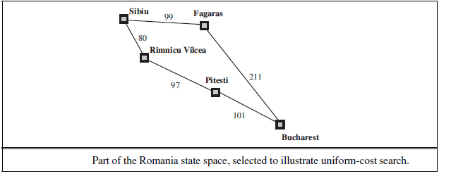
Uniform Cost Search

Slide 21
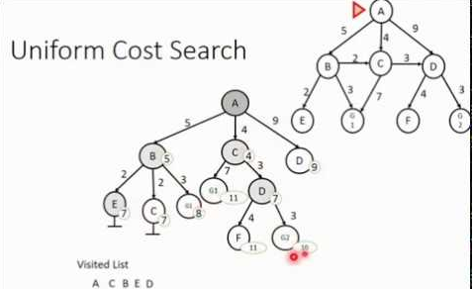
Uniform cost search

Slide 22
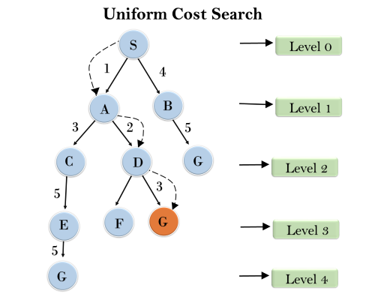
Uniform cost search

Slide 23
Uniform-cost search
Expand least-cost (of path to) unexpanded node
(e.g. useful for finding shortest path on map) Implementation:
fringe = queue ordered by path cost
Complete? Yes, if step cost ≥ ε (>0) Time? # of nodes with g ≤ cost of optimal solution (C*), O(b^{(1+⎣C*/ ε⎦})
Space? # of nodes with g ≤ cost of optimal solution,
O(b^{(1+⎣C*/ ε⎦})
Optimal? Yes – nodes expanded in increasing order of g(n)
Note: Some subtleties (e.g. checking for goal state).
See p 84 R&N. Also, next slide.
g – cost of reaching a node

Slide 24
Uniform-cost search
Two subtleties: (bottom p. 83 Norvig)
Do goal state test, only when a node is selected for expansion.
(Reason: Bucharest may occur on frontier with a longer than
optimal path. It won’t be selected for expansion yet. Other nodes
will be expanded first, leading us to uncover a shorter path to
Bucharest. See also point 2).
2) Graph-search alg. says “don’t add child node to frontier if already on
explored list or already on frontier.” BUT, child may give a shorter path
to a state already on frontier. Then, we need to modify the existing
node on frontier with the shorter path. See fig. 3.14 (else-if part).

Slide 25
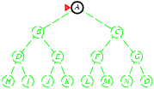
Depth-first search
“Expand deepest unexpanded node”
Implementation:
fringe = LIFO queue, i.e., put successors at front (“push on stack”)
Last In First Out
Fringe stack:
A
Expanding A,
gives stack:
B
C
So, B next.

Slide 26
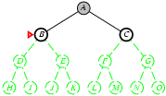
Expanding B, gives stack:
D
E
C
So, D next.

Slide 27
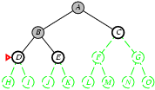
Expanding D, gives stack:
H
I
E
C
So, H next.
etc.

Slide 28
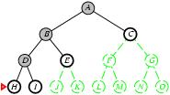

Slide 29
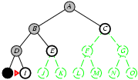

Slide 30
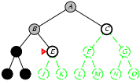

Slide 31
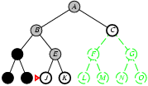

Slide 32
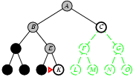

Slide 33
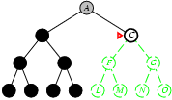

Slide 34
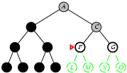

Slide 35
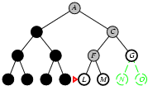

Slide 36
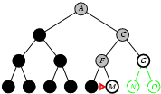

Slide 37
Properties of depth-first search
Complete?
Time? O(b^{m}): bad if m is much larger than d
but if solutions are dense, may be much faster than breadth-first
Space?
Guarantee that
opt. soln. is found?
No: fails in infinite-depth spaces, spaces with loops
Modify to avoid repeated states along path
→ complete in finite spaces
Note: Can also reconstruct soln. path from single stored branch.
O(bm), i.e., linear space!
b: max. branching factor of the search tree
d: depth of the shallowest (least-cost) soln.
m: maximum depth of state space
No
Note: In “backtrack search” only one successor is generated
→ only O(m) memory is needed; also successor is modification of
the current state, but we have to be able to undo each modification.
More when we talk about Constraint Satisfaction Problems (CSP).

Slide 38
Depth Limited Search

Slide 39
Complexity analysis
Completeness | If l < d, incomplete
Time Complexity | O(b^{l})
Space Complexity | O(bl)
Optimality | If l > d, non optimal

Slide 40
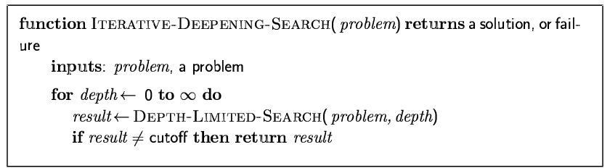
Iterative deepening search
[here]

Slide 41
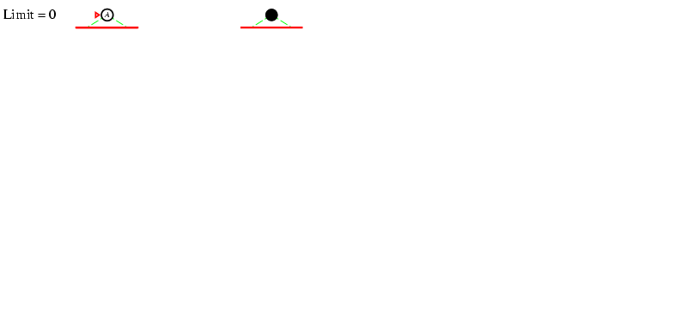
Iterative deepening search l =0

Slide 42
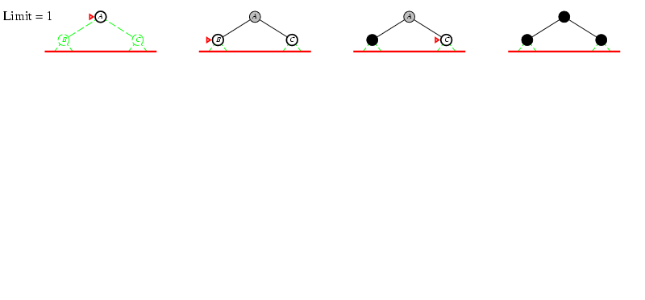
Iterative deepening search l =1

Slide 43
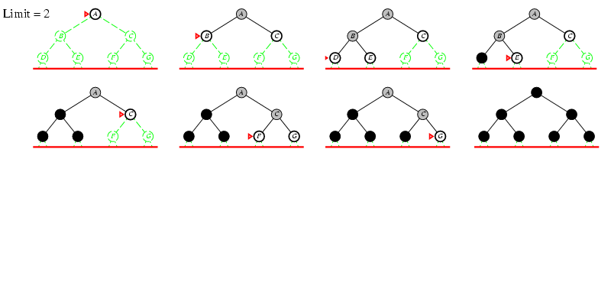
Iterative deepening search l =2

Slide 44
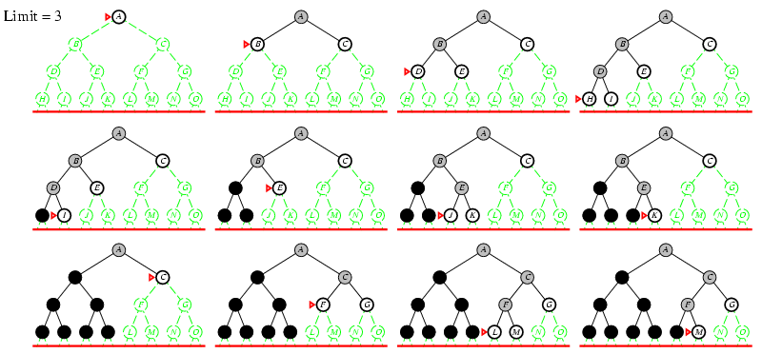
Iterative deepening search l =3

Slide 45
Why would one do that?
Combine good memory requirements of depth-first with
the completeness of breadth-first when branching factor is
finite and is optimal when the path cost is a non-decreasing
function of the depth of the node.
Idea was a breakthrough in game playing. All game
tree search uses iterative deepening nowadays. What’s
the added advantage in games?
“Anytime” nature.

Slide 46
Iterative deepening search
Number of nodes generated in an iterative deepening search to depth
d with branching factor b:
N_{IDS} = d b¹ + (d-1)b² + … + 3b^{d-2} +2b^{d-1} + 1b^{d}
Nodes generated in a breadth-first search with branching factor b:
N_{BFS} = b¹ + b² + … + b^{d-2} + b^{d-1} + b^{d}
For b = 10, d = 5,
N_{BFS}= 10 + 100 + 1,000 + 10,000 + 100,000 = 111,110
N_{IDS} = 50 + 400 + 3,000 + 20,000 + 100,000 = 123,456
Looks quite wasteful, is it?
☺
Iterative deepening is the preferred uninformed search method
when there is a large search space and the depth of the solution
is not known.

Slide 47
Properties of iterative deepening search
Complete? Yes (b finite)
Time? d b¹ + (d-1)b² + … + b^{d} = O(b^{d})
Space? O(bd)
Optimal? Yes, if step costs identical

Slide 48
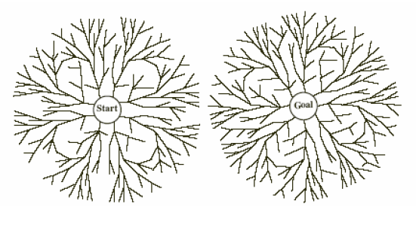
Bidirectional Search
Simultaneously:
Search forward from start
Search backward from the goal
Stop when the two searches meet.
If branching factor = b in each direction,
with solution at depth d
➔ only O(2 b^{d/2})= O(2 b^{d/2})
Checking a node for membership in the other search tree can be done in constant time (hash table)
Key limitations:
Space O(b^{d/2})
Also, how to search backwards can be an issue (e.g., in Chess)? What’s tricky?
Problem: lots of states satisfy the goal; don’t know which one is relevant.
Aside: The predecessor of a node should be easily computable (i.e., actions are easily reversible).

Slide 49
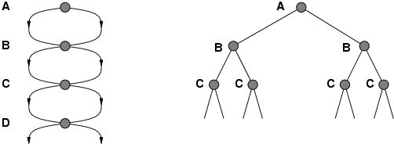
Repeated states
Failure to detect repeated states can turn
linear problem into an exponential one!
Don’t return to parent node
Don’t generate successor = node’s parent
Don’t allow cycles
Don’t revisit state
Keep every visited state in memory! O(b^{d}) (can be expensive)
Problems in which actions are reversible (e.g., routing problems or sliding-blocks puzzle). Also, in eg Chess; uses hash tables to check
for repeated states. Huge tables 100M+ size but very useful.
See Tree-Search vs. Graph-Search in Fig. 3.7 R&N. But need to
be careful to maintain (path) optimality and completeness.

Slide 50
Summary: General, uninformed search
Original search ideas in AI where inspired by studies of human problem solving in, eg, puzzles, math, and games, but a great many AI tasks now require some form of search (e.g. find optimal agent strategy; active learning; constraint reasoning; NP-complete problems require search).
Problem formulation usually requires abstracting away real-world details to define a state space that can feasibly be explored.
Variety of uninformed search strategies
Iterative deepening search uses only linear space and not much more time than other uninformed algorithms.
Avoid repeating states / cycles.

